Slide 1
Module #19:
Relations (2)
26年 11月 8日
©2001-2004 Michael P. Frank, revised by S. Kang

Slide 2
§7.3: Representing Relations
Some ways to represent n-ary relations:
  With an explicit list or table of its tuples.
  With a function from the domain to {T,F}.
    Or with an algorithm for computing this function.
Some special ways to represent binary relations:
  With a zero-one matrix.
  With a directed graph.
26年 11月 8日
©2001-2004 Michael P. Frank, revised by S. Kang

Slide 3
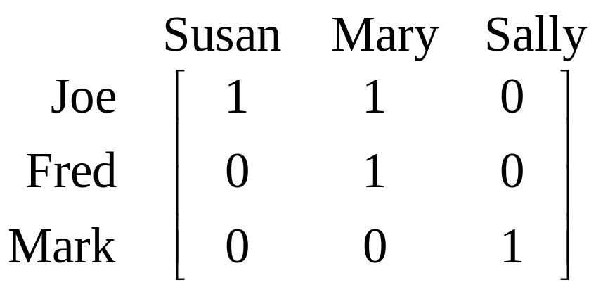
Using Zero-One Matrices
To represent a binary relation R:A×B by an |A|×|B| 0-1 matrix M_{R} = [m_{ij}], let m_{ij} = 1 iff (a_{i},b_{j})∈R.
E.g., Suppose Joe likes Susan and Mary, Fred likes Mary, and Mark likes Sally.
Then the 0-1 matrix
representation
of the relation
Likes:Boys×Girls
relation is:
26年 11月 8日
©2001-2004 Michael P. Frank, revised by S. Kang

Slide 4
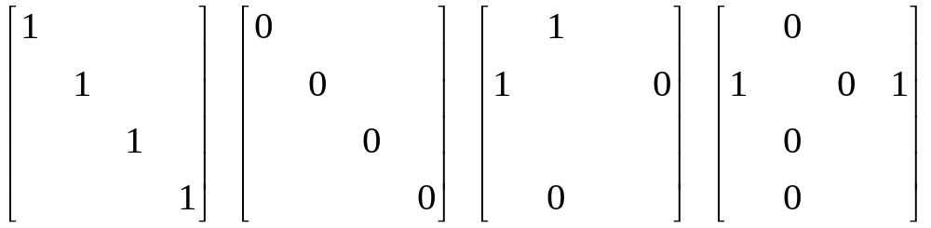
Zero-One Reflexive, Symmetric
Terms: Reflexive, irreflexive, Symmetric, and antisymmetric.
  These relation characteristics are very easy to recognize by inspection of the zero-one matrix.
any-
thing
any-
thing
anything
anything
any-
thing
any-
thing
Reflexive:
all 1’s on diagonal
Irreflexive:
all 0’s on diagonal
Symmetric:
all identical
across diagonal
Antisymmetric:
all 1’s are across
from 0’s
26年 11月 8日
©2001-2004 Michael P. Frank, revised by S. Kang

Slide 5
Using Directed Graphs
A directed graph or digraph G=(V_{G},E_{G}) is a set V_{G} of vertices (nodes) with a set E_{G}⊆V_{G}×V_{G} of edges (arcs,links). Visually represented using dots for nodes, and arrows for edges. Notice that a relation R:A×B can be represented as a graph G_{R}=(V_{G}=A∪B, E_{G}=R).
Edge set E_{G}
(blue arrows)
Matrix representation M_{R}:
Graph
rep. G_{R}:
Joe
Susan
Fred
Mary
Mark
Sally
Node set V_{G}
(black dots)
26年 11月 8日
©2001-2004 Michael P. Frank, revised by S. Kang

Slide 6
Digraph Reflexive, Symmetric
It is extremely easy to recognize the reflexive/irreflexive/ symmetric/antisymmetric properties by graph inspection.











Reflexive:
Every node
has a self-loop
Irreflexive:
No node
links to itself
Symmetric:
Every link is
bidirectional
Antisymmetric:
No link is
bidirectional
26年 11月 8日
©2001-2004 Michael P. Frank, revised by S. Kang

Slide 7
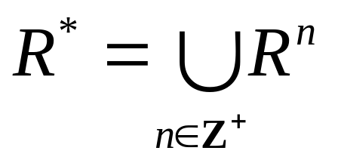
§7.4: Closures of Relations
For any property X, the “X closure” of a set A is defined as the “smallest” superset of A that has the given property.
The reflexive closure of a relation R on A is obtained by adding (a,a) to R for each a∈A. I.e., it is R ∪ I_{A}
The symmetric closure of R is obtained by adding (b,a) to R for each (a,b) in R. I.e., it is R ∪ R⁻¹
The transitive closure or connectivity relation of R is obtained by repeatedly adding (a,c) to R for each (a,b),(b,c) in R.
  I.e., it is
26年 11月 8日
©2001-2004 Michael P. Frank, revised by S. Kang

Slide 8
Paths in Digraphs/Binary Relations
A path of length n from node a to b in the directed graph G (or the binary relation R) is a sequence (a,x₁), (x₁,x₂), …, (x_{n−1},b) of n ordered pairs in E_{G} (or R).
  An empty sequence of edges is considered a path of length 0 from a to a.
  If any path from a to b exists, then we say that a is connected to b. (“You can get there from here.”)
A path of length n≥1 from a to itself is called a circuit or a cycle.
Note that there exists a path of length n from a to b in R if and only if (a,b)∈R^{n}.
26年 11月 8日
©2001-2004 Michael P. Frank, revised by S. Kang

Slide 9
§7.5: Equivalence Relations
An equivalence relation (e.r.) on a set A is simply any binary relation on A that is reflexive, symmetric, and transitive.
  E.g., = itself is an equivalence relation.
  For any function f:A→B, the relation “have the same f value”, or =_{f} :≡ {(a₁,a₂) | f(a₁)=f(a₂)}
  is an equivalence relation,
    e.g., let m=“mother of” then =_{m} = “have the same mother” is an e.r.
26年 11月 8日
©2001-2004 Michael P. Frank, revised by S. Kang

Slide 10
Equivalence Relation Examples
“Strings a and b are the same length.”
“Integers a and b have the same absolute value.”
“Real numbers a and b have the same fractional part.” (i.e., a − b ∈ Z)
“Integers a and b have the same residue modulo m.” (for a given m>1)
26年 11月 8日
©2001-2004 Michael P. Frank, revised by S. Kang

Slide 11
Equivalence Classes
Let R be any equiv. rel. on a set A.
The equivalence class of a,
[a]_{R} :≡ { b | aRb } (optional subscript R)
  It is the set of all elements of A that are “equivalent” to a according to the eq.rel. R.
  Each such b (including a itself) is called a representative of [a]_{R}.
Since f(a)=[a]_{R} is a function of a, any equivalence relation R can be defined using
aRb :≡ “a and b have the same f value”, given f.
26年 11月 8日
©2001-2004 Michael P. Frank, revised by S. Kang

Slide 12
Equivalence Class Examples
“Strings a and b are the same length.”
  [a] = the set of all strings of the same length as a.
“Integers a and b have the same absolute value.”
  [a] = the set {a, −a}
“Real numbers a and b have the same fractional part (i.e., a − b ∈ Z).”
  [a] = the set {…, a−2, a−1, a, a+1, a+2, …}
“Integers a and b have the same residue modulo m.” (for a given m>1)
  [a] = the set {…, a−2m, a−m, a, a+m, a+2m, …}
26年 11月 8日
©2001-2004 Michael P. Frank, revised by S. Kang

Slide 13
Partitions
A partition of a set A is the set of all the equivalence classes {A₁, A₂, … } for some equivalence relation on A.
  The A_{i}’s are all disjoint and their union = A.
They “partition” the set into pieces. Within each piece, all members of that set are equivalent to each other.
26年 11月 8日
©2001-2004 Michael P. Frank, revised by S. Kang

Slide 14
§7.6: Partial Orderings
A relation R on A is called a partial ordering or partial order iff it is reflexive, antisymmetric, and transitive.
  We often use a symbol looking something like ≼ (or analogous shapes) for such relations.
  Examples: ≤, ≥ on real numbers, ⊆, ⊇ on sets.
  Another example: the divides relation | on Z⁺.
A set A together with a partial order ≼ on A is called a partially ordered set or poset and is denoted (A, ≼).
26年 11月 8日
©2001-2004 Michael P. Frank, revised by S. Kang

Slide 15
Posets as Noncyclical Digraphs
There is a one-to-one correspondence between posets and the reflexive+transitive closures of noncyclical digraphs.
  Noncyclical: Containing no directed cycles.
Example: consider the poset ({0,…,10},|)
  Its minimal
  digraph:
2
4
8
1
3
6
0
5
9
7
10
26年 11月 8日
©2001-2004 Michael P. Frank, revised by S. Kang

